Slide 1
Melting and Sintering of Ni Nanoparticles
Umang Agarwal 19110173
Patel Vashisth 19110158
Shubham Saurabh 19110168
In the guidance of:
Prof. Raghavan Ranganathan

Slide 2
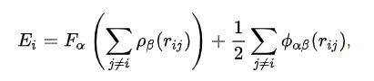
Introduction
Using EAM potential, we simulated Melting and Sintering behaviour of Nickel Nano-particle.
For Melting: We worked at different heating rates in order to obtain an optimum run-time for the simulation. After that, we changed nanoparticle size at constant heating rate and determined melting behaviour for different nano-particles sizes
For Sintering: We sintered 3 nanoparticles of similar sizes in order to understand the sintering behaviour of Nickel nanoparticle. We inferred about the change in number of particles around neck region and visualized the variation of potential energy/atom.

Slide 3
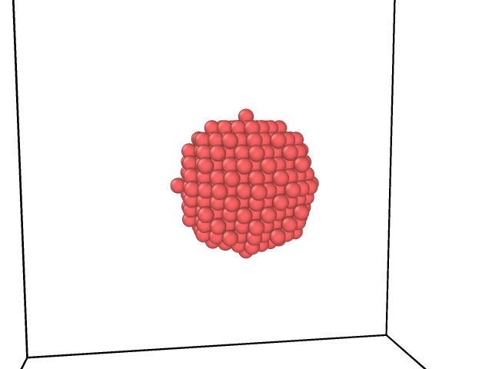
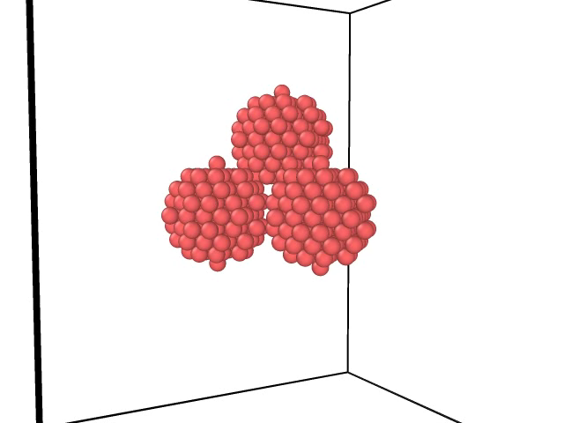
Melting and Sintering Behaviour of Nickel Nanoparticles
Fig1. Melting Simulation of 3nm Ni Nanoparticle
Fig2. Sintering Simulation of 2nm Ni Nanoparticles

Slide 4
Melting of Ni Nanoparticles
1

Slide 5
Effect of heating rate
Fig 2. Plot for 3nm particle for run time= 300ps
Fig 3. Plot for 3nm particle size

Slide 6
Effect of nanoparticle size
Fig 4. Plot for heating rate= 0.0019 K/fs, Nanoparticle radius= 4nm
Fig 5. Plot at heating rate= 0.0019 K/fs

Slide 7
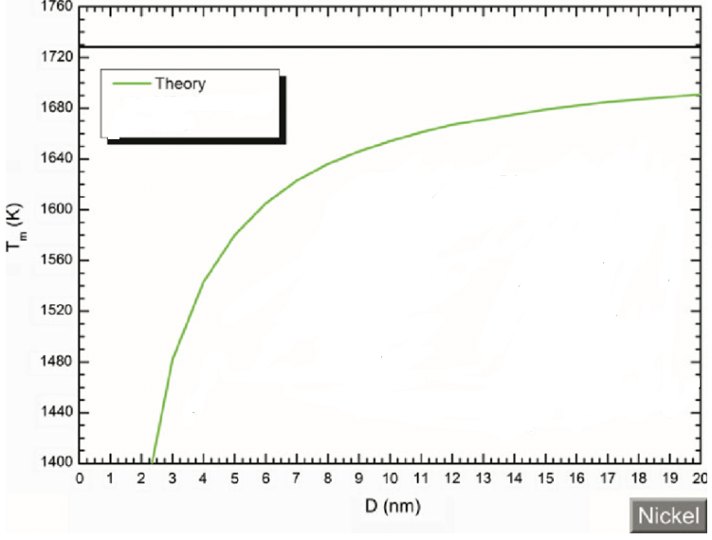
Comparison with Theoretical Results
Fig 4. Theoretical Plot for Melting Temperature v/s Size
Fig 4. Simulated Plot for Melting Temperature v/s Size

Slide 8
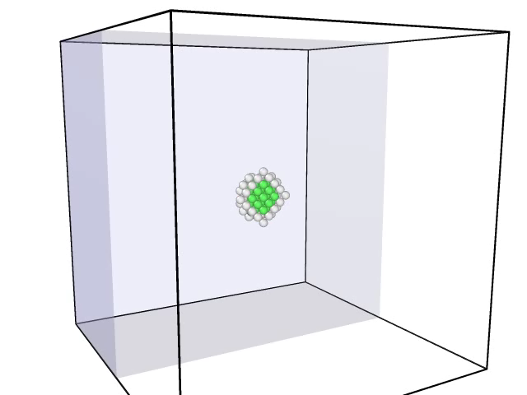
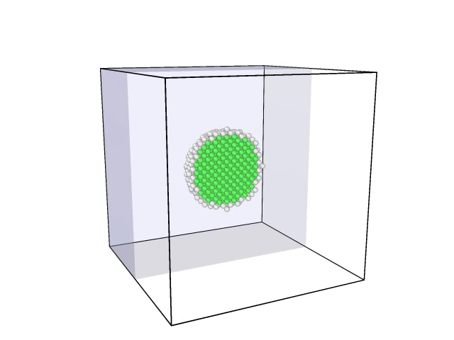
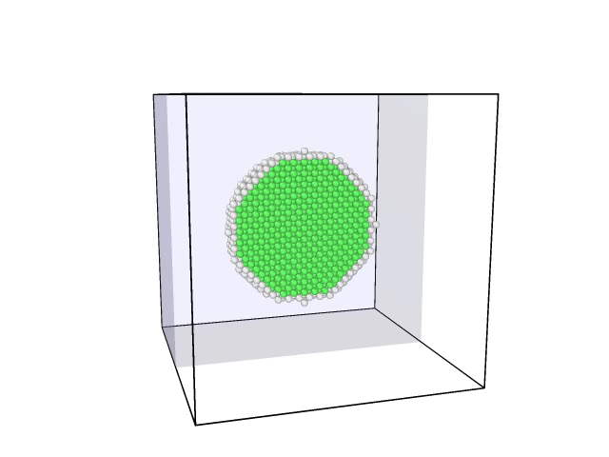
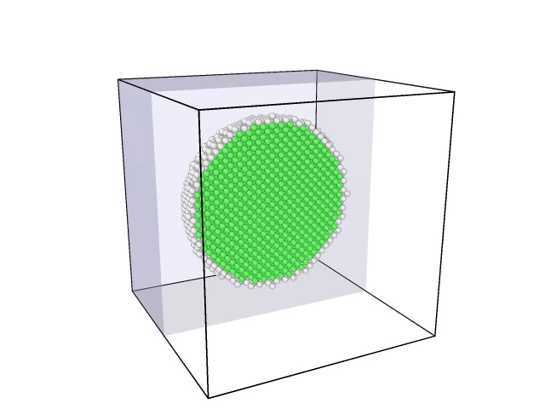
Structural Analysis
Fig.6 Radius =3nm
Fig.7 Radius =5nm
Fig.8 Radius =7nm
Fig.9 Radius =9nm

Slide 9
Sintering of Ni Nanoparticles
2

Slide 10
Effect on total Potential Energy
Fig 10. Plot total potential energy with time for radius = 2

Slide 11
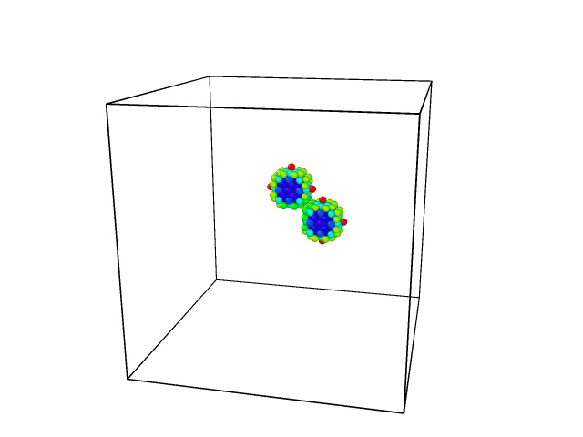
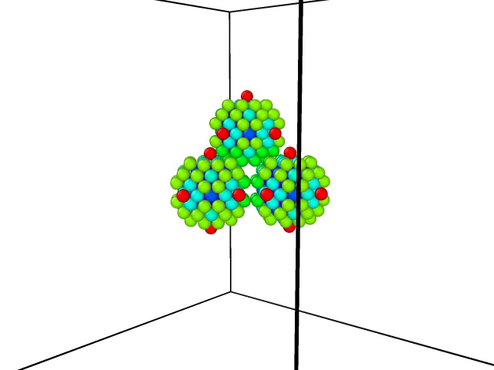
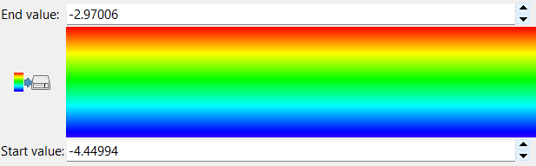
Change in P.E/atom during Sintering
Fig 11. Energy of atoms in sintering simulation.
Fig 12. Color Coded Sintering Simulation

Slide 12
Number of atoms in Neck Region
Fig 13. Plot for number of atoms near spherical neck region for r=1nm

Slide 13
THANKS!

